Slide 1
CURILUX DIABETICS APP Under The Guidance Of Prof. Deepa M Prof. Praveenkumar M
Presented by
Purushottam pattanashetty(01fe21mca032)

Slide 2
Agenda
INTRODUCTION
SYSTEM ANALYSIS
SYSTEM REQUIREMENTS
SYSTEM DESIGN
IMPLIMENTATION
TESTING
SCREENSHOT

Slide 3
INTRODUCTION
Diabetics app is designed to control the information related patients.
The application is will provide intended information related to doctors and patients.
The application will provide platform to maintain patients information.
The application can be accessed on any devices with help of internet.

Slide 4
SYSTEM ANALYSIS
The application provides an interface to maintain diabetics patients regularly.
The application can detect the diabetics stage and assign doctors with patients data.
Customer agents will get the information from patients and get confirmation of subscription.
The doctor and patient can access application anywhere anytime with the help of internet.
The application is secured and has access to known users only.

Slide 5
HARDWARE & SOFTWARE SPECIFICATION
Hardware component | Description
Memory | Minimum 8GB
Hard Disk | Minimum 512GB
Processor | Core i5
Software component | Description
Operating System | Windows 10 Home
Text Editor | VS Code
Scripting Language | JavaScript
Framework | Laravel(PHP),Flutter
Database | MySQL
Server | Apache

Slide 6
MODULES
Customer Agent
Patient
Doctor

Slide 7
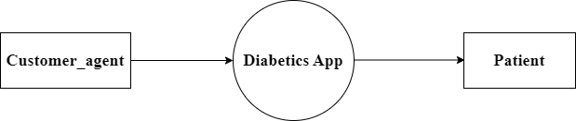
DATA FLOW DIAGRAMS
Context level

Slide 8
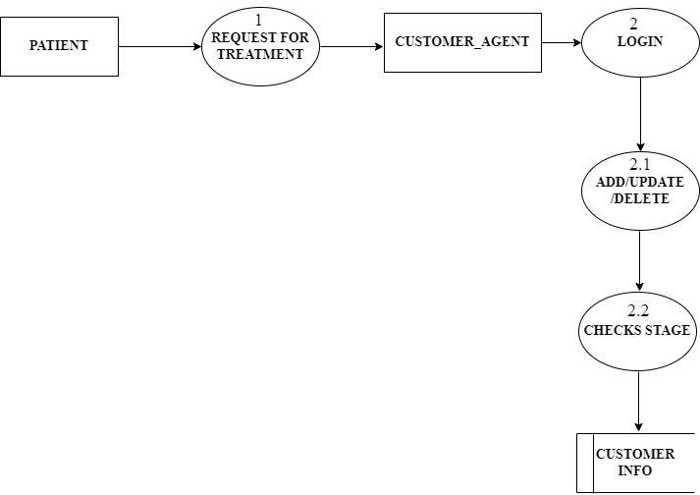
DATA FLOW DIAGRAMS
Level 1 DFD

Slide 9

DATA FLOW DIAGRAMS
Level-1 DFD for doctor form

Slide 10
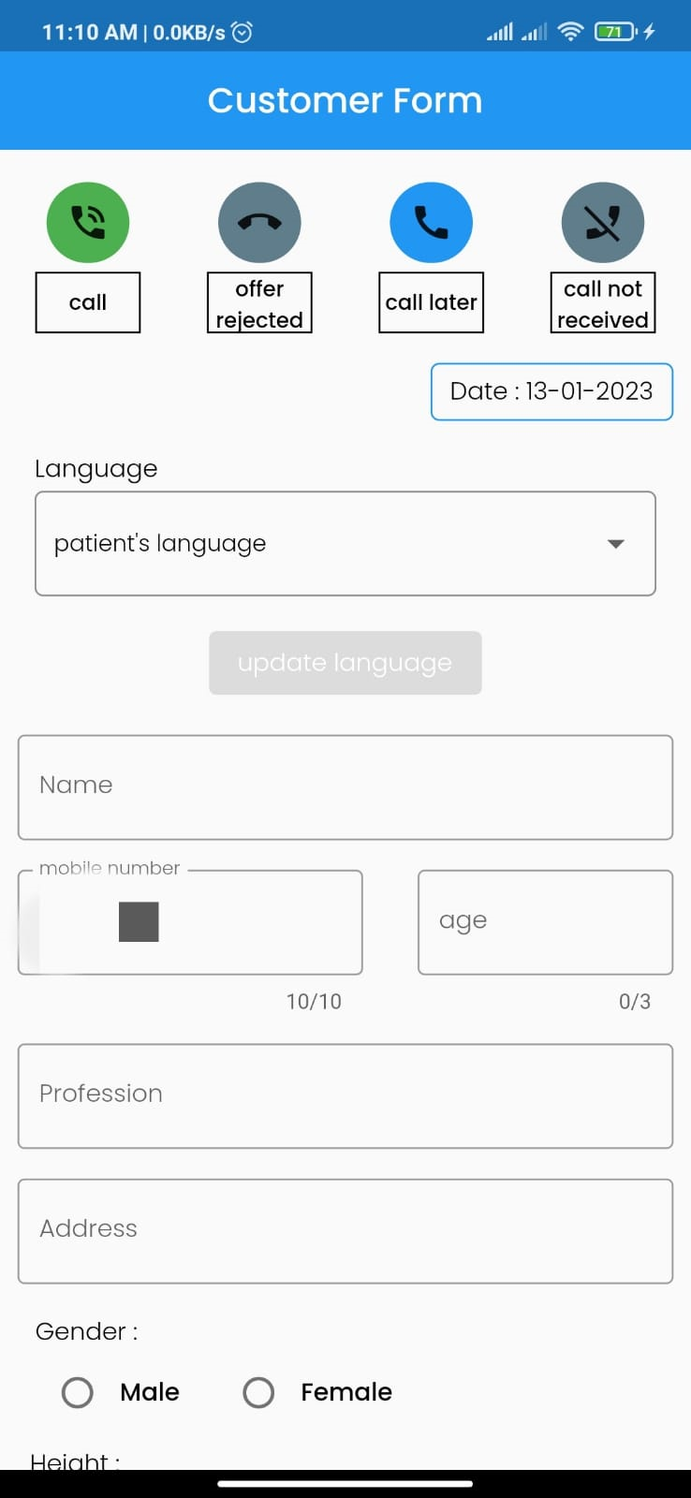
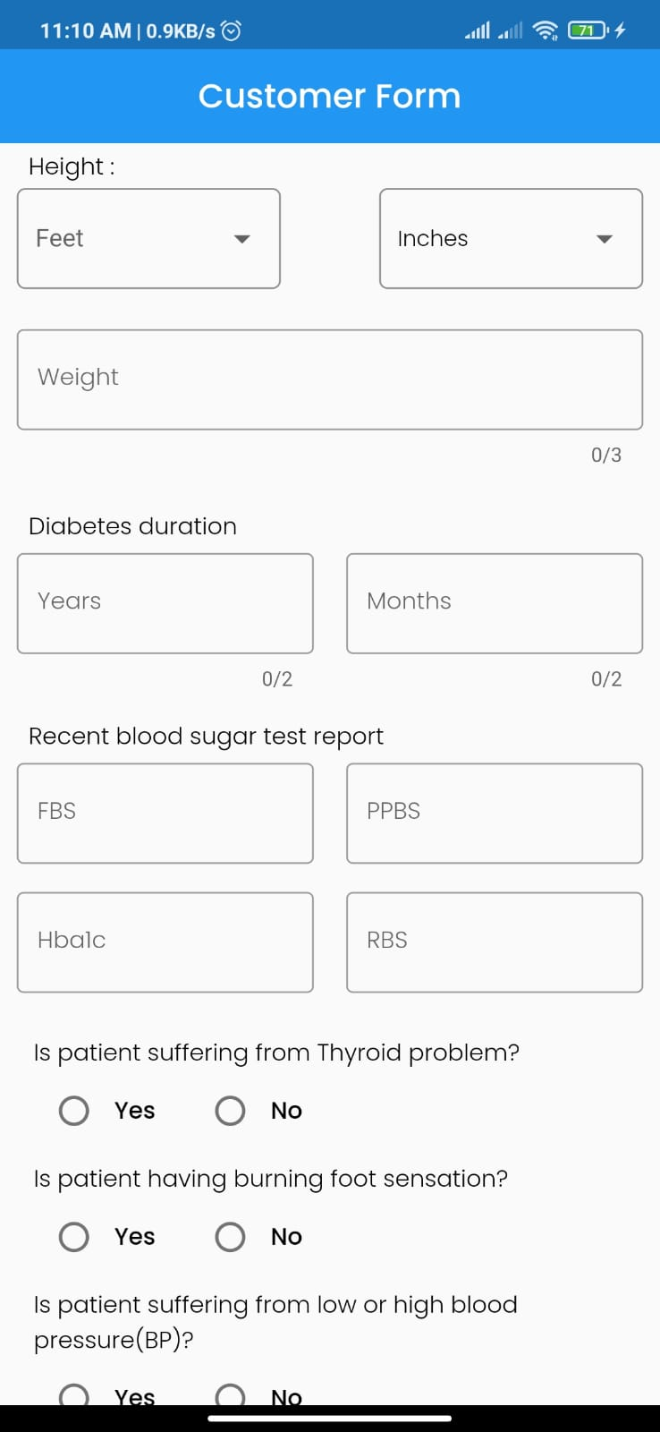
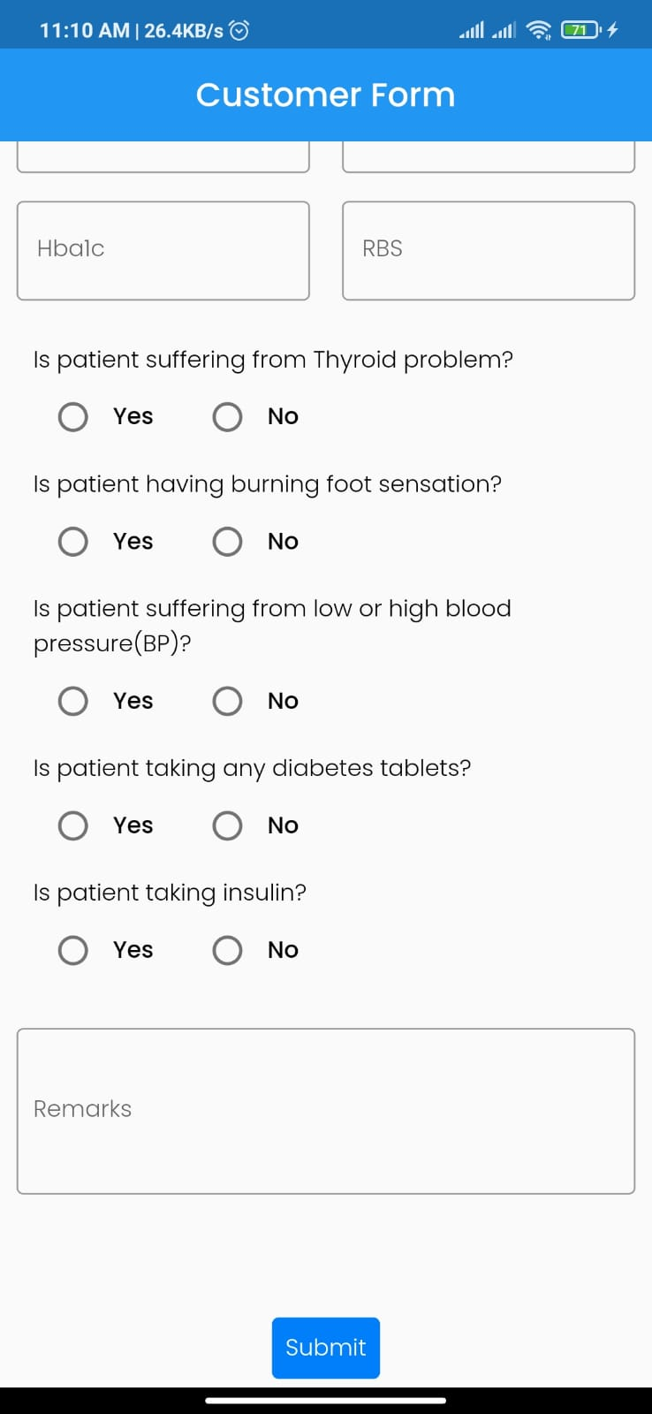
SCRENSHOTS

Slide 11
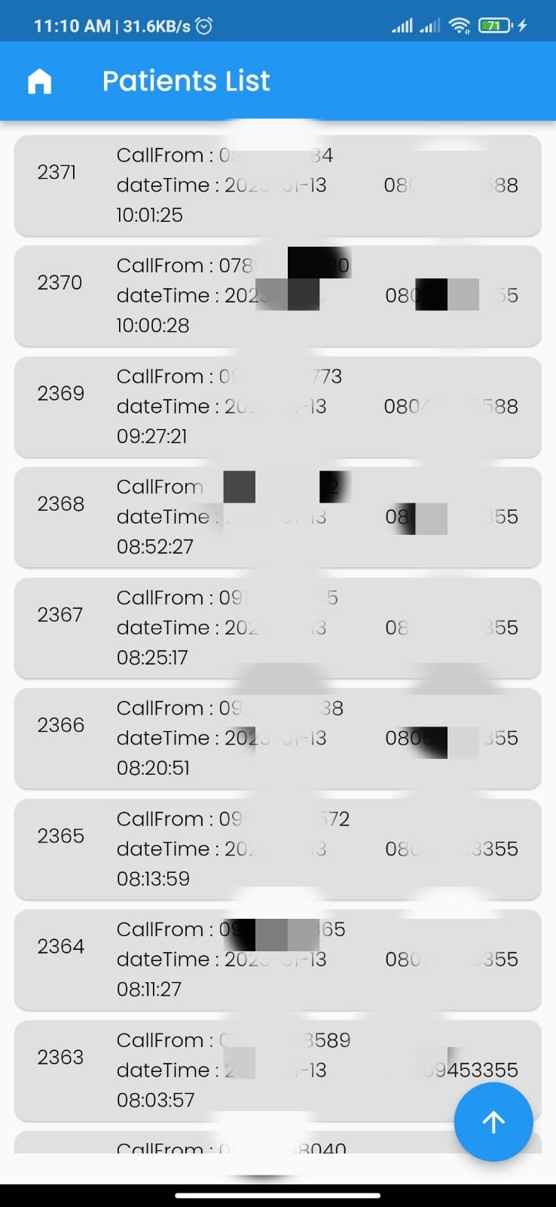
SCRENSHOTS

Slide 12
FUTURE ENHANCEMENT
This system may also feature a teleconsultation option, in which patients can directly contact a doctor and obtain advice on their problems.
This application allows users to manage not just consultations but also medical test appointments.

Slide 13
Thank You

